Slide 1
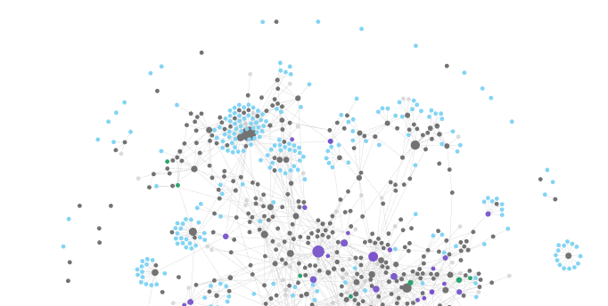
PERSONAL WIKIPEDIA
How Obsidian can help you build connections between your notes for school, work & creative projects
Samantha Yuen
samantha.yuen@umontreal.ca May 6, 2021
Notes:
Permission for recording for self-improvement purposes. The recording will not be distributed.
Remind students that the presentation slides will be shared.

Slide 2
Breakout Rooms
How & why do you take notes?
Did you download Obsidian yet?
Did you read an article before the workshop?
Get in groups of 3-4.
Have one person answering the question and one person with a timer.
Alternate every minute.
Write in the chat your answers for #2 and #3
6-8 min
Notes:
Survey Questions
What do you take notes of? (i.e. lectures, plans, lists, journaling, projects, etc)
What tools do you use to take notes?
Pen & Paper
Word / Google Docs
One Note
I don’t take notes
Other (text field)

Slide 3

Notes:
Notes:
They can get messy
Especially during midterms!
Physical notebooks, journals, and papers get stored in a boxes and shelves
Digital notes can be forgotten in our endlessly nested folders
Let’s say you were in a course that expanded on a concept that you learned in a previous class? Would you try to find it under this giant backlog of files, or rewrite it altogether?
That’s not terribly efficient.

Slide 4
Instead of storing away our notes, what if we could keep building and updating what we know in a unified space?

Slide 5
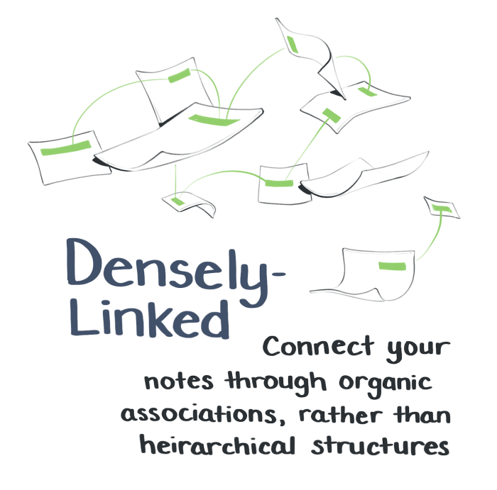
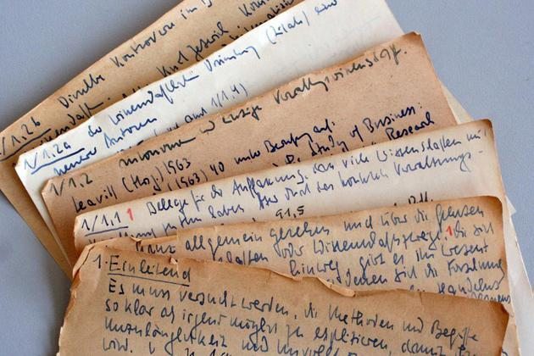
The Personal Wikipedia
A reference for information the way you understand it
You decide the file structure & organization
The structure, content and workflow evolves over time as you use it
Evergreen Notes by Andy Matuschak
Zettelkasten by Niklas Luhmann
Notes:
What I’m introducing is not invented by me, but adapted from Evergreen Notes + Zettelkasten Method and inspired by the Building a Second Brain Movement that’s been gaining popularity the past few years.

Slide 6
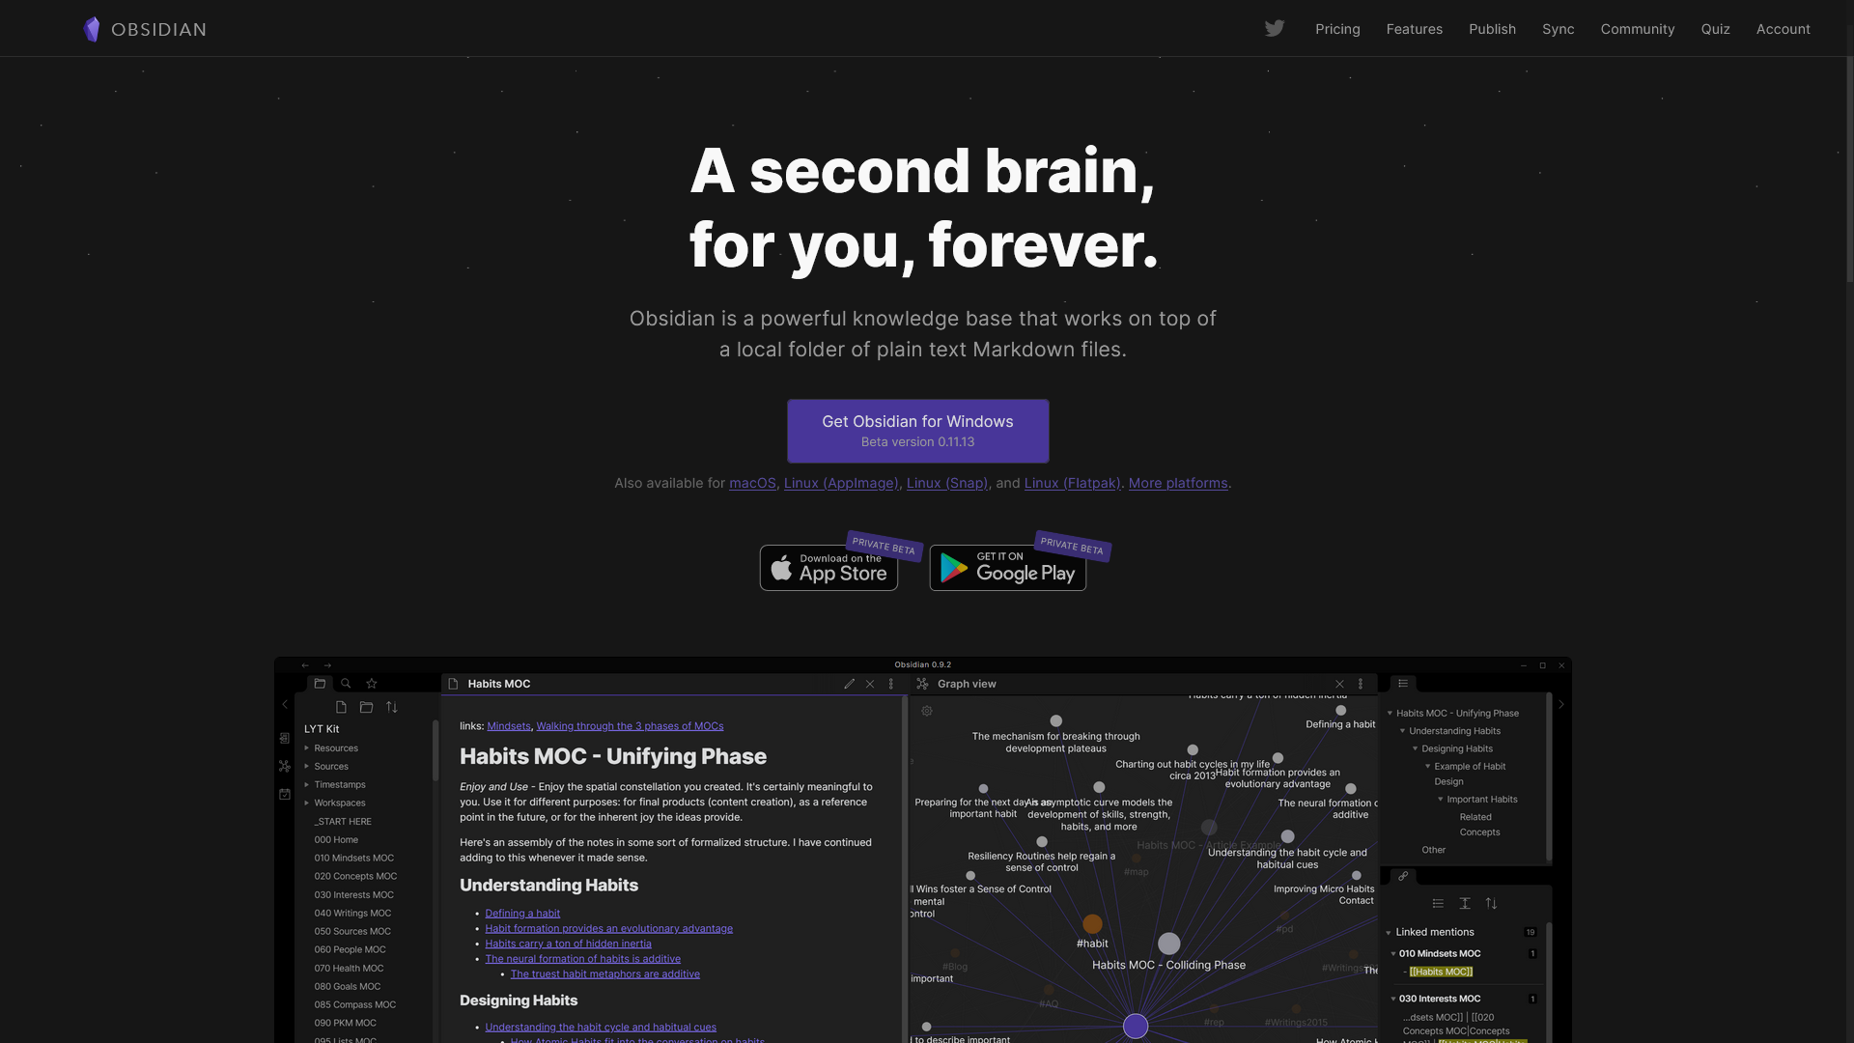
Markdown Editor
Locally Stored (secure)
Easy to link to notes
You decide the structure
Notes:
https://obsidian.md
I personally think Obsidian is most efficient way to make a personal wikipedia.
Note-taking app
Edits files called Markdown (used by software devs a lot for documentation)
Normal Desktop folder as vault
Links can be made between any note, image, pdf, etc
Make your own structure with folders or the notes themselves.
For those that are more code-savvy:
Uses Electron, so perfect for injecting html, iframes, and css.
Survey Questions:
Are you familiar with Obsidian? (yes/ no / heard of it)
Are you familiar with markdown? (yes/ no/ heard of it)

Slide 7
Outline
What can you do with Obsidian?
Obsidian vs Other Apps
Walkthroughs
Obsidian Basics
Setting up Obsidian + What is Markdown + Main Features of Obsidian
Create personal notes from an article
Resources + Questions

Slide 8
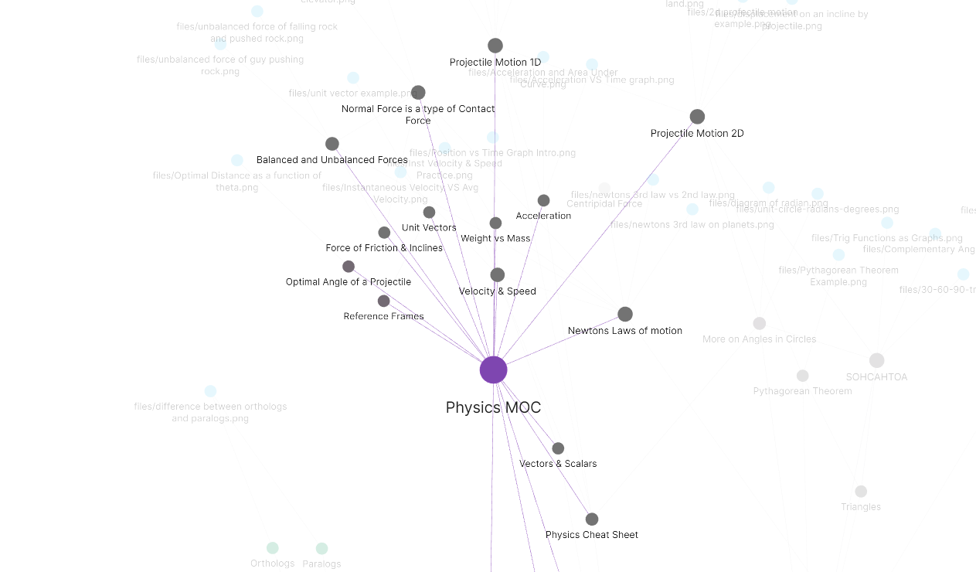
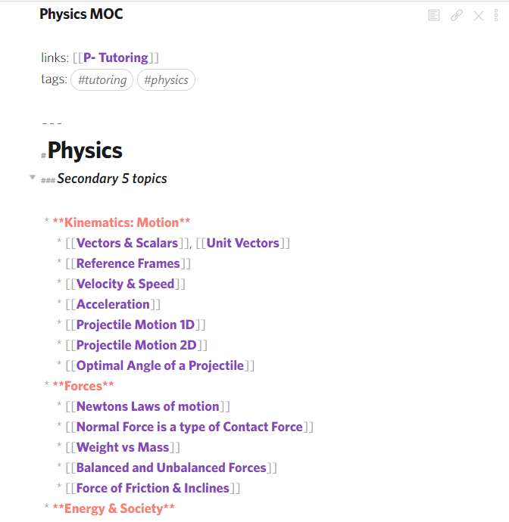
Obsidian allows us to easily create links in our notes
Notes:
High school tutoring notes
Imagine you have a course syllabus, you create a note listing all the topics in your syllabus
In a separate course,
if there’s a topic that elaborates on the same topic, you can use the same note without having to rewrite it!
If there’s a new topic that needs you to know about a topic from a course you took, you can easily reference it

Slide 9
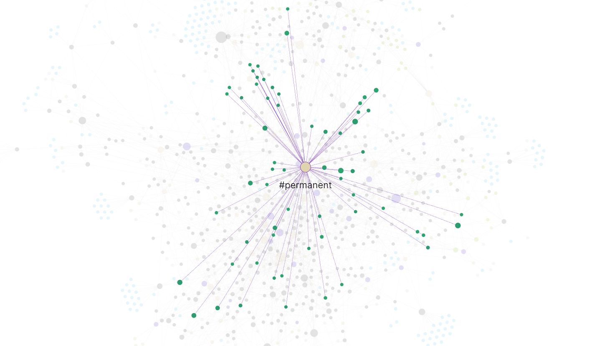
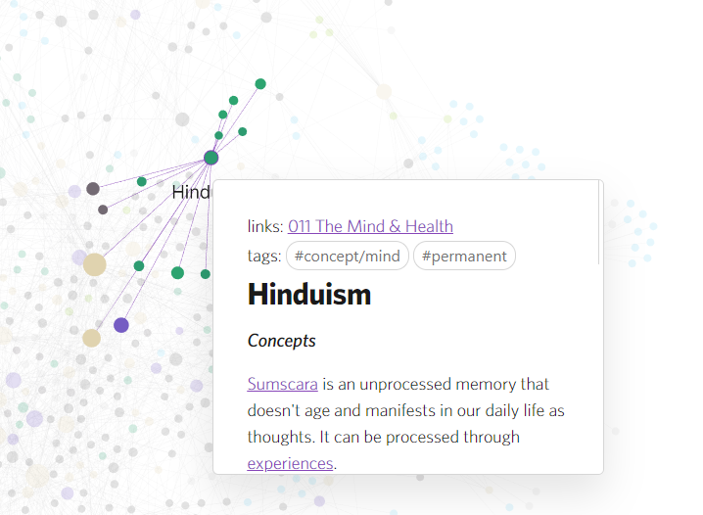
Obsidian allows us to easily create links in our notes
Notes:
Obsidian gives us the ability to link our notes together:
Notes can be tagged and they would be very easy to find on the graph view or in search tab.

Slide 10
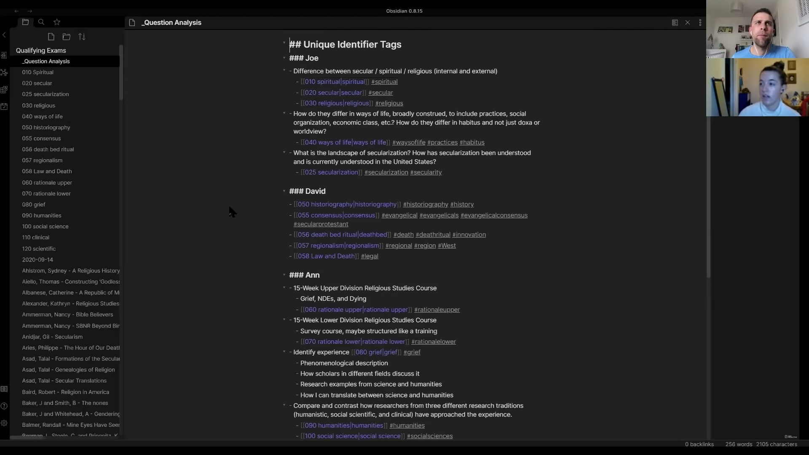
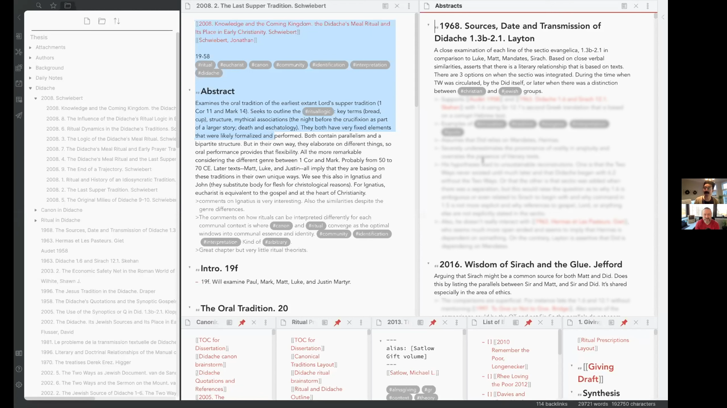
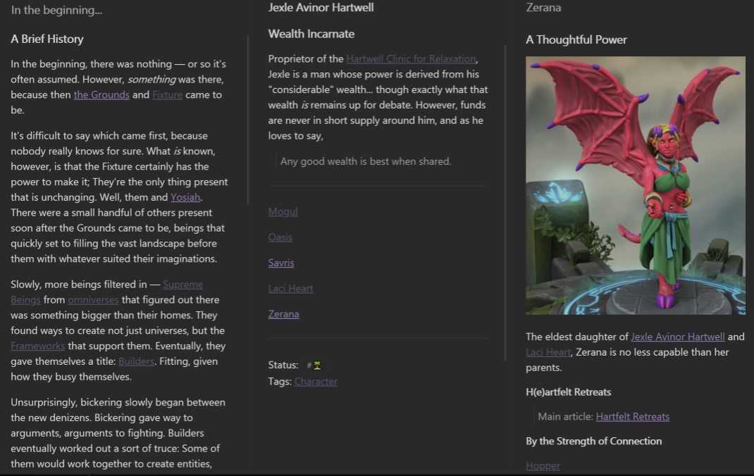
Examples of Other use Cases
Research [1][2]
World Building for Writers
Outlining papers/ Projects
Workplace Notes
University Notes
Others
Notes:
Everyone has different reasons for using a Personal Wikipedia
Journalists: Collect and connect different sources and article together, final product is a paper on word
Research: Collection and connection of research papers, and personal thoughts, lab book
University Students: Their vault is the ground truth and things in their should be accurate for the sake of preparing for exams
Workplace: Collecting notes on what you learned, Journaling, monitoring personal development
Creating a vault the transforms a PDF documentation into an interactive and connected vault of notes
For workplace notes, it’s clear that if there is proprietary information, then you may need to discuss with your employer about that.
Writers: Highly interconnected space of notes that connect their characters, plot points and research for historical accuracy etc.
I’ll show some more as well once we get into the workshop

Slide 11
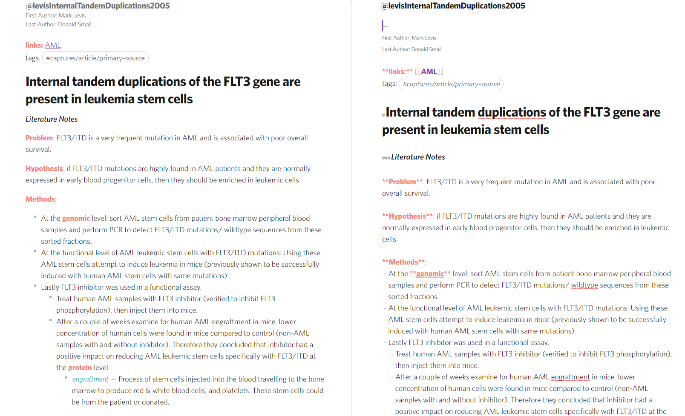

Slide 12
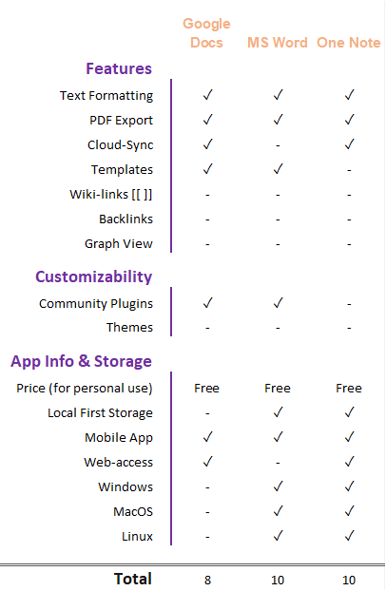
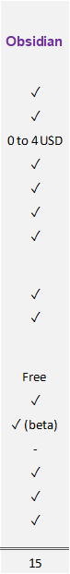
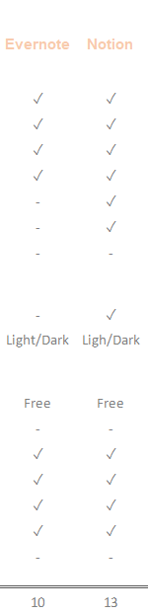
How do Other Note-taking Apps Compare?
Notes:
What makes Obsidian stand out are its implementation of wiki-links and back-links.
Easily link notes together without going through a bunch of menus
Back-links: keeps a list of what notes point to the one you’re looking at and suggests notes with same words as the title.
Community
Google Docs (limited by what Google supports as addons)
MS Word (Zotero citations)
Markdown + Obsidian makes it easy to mass edit notes and compile information from it while also making it visually organized and appealing.
Lack of browser access could be a deal breaker for some people, but The mobile app is coming to the public soon, so viewing it on android or IOS devices will overcome that.
Still in beta and constantly evolving
Well supported by community developers

Slide 13
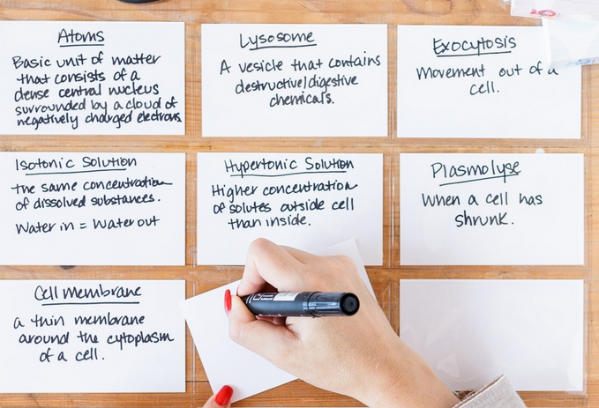
Notes:
Graph View: Those that learn through visuals
Mind maps
Index cards
Obsidian is a great digital and light-weight tool for this application.

Slide 14
Walkthroughs

Slide 15
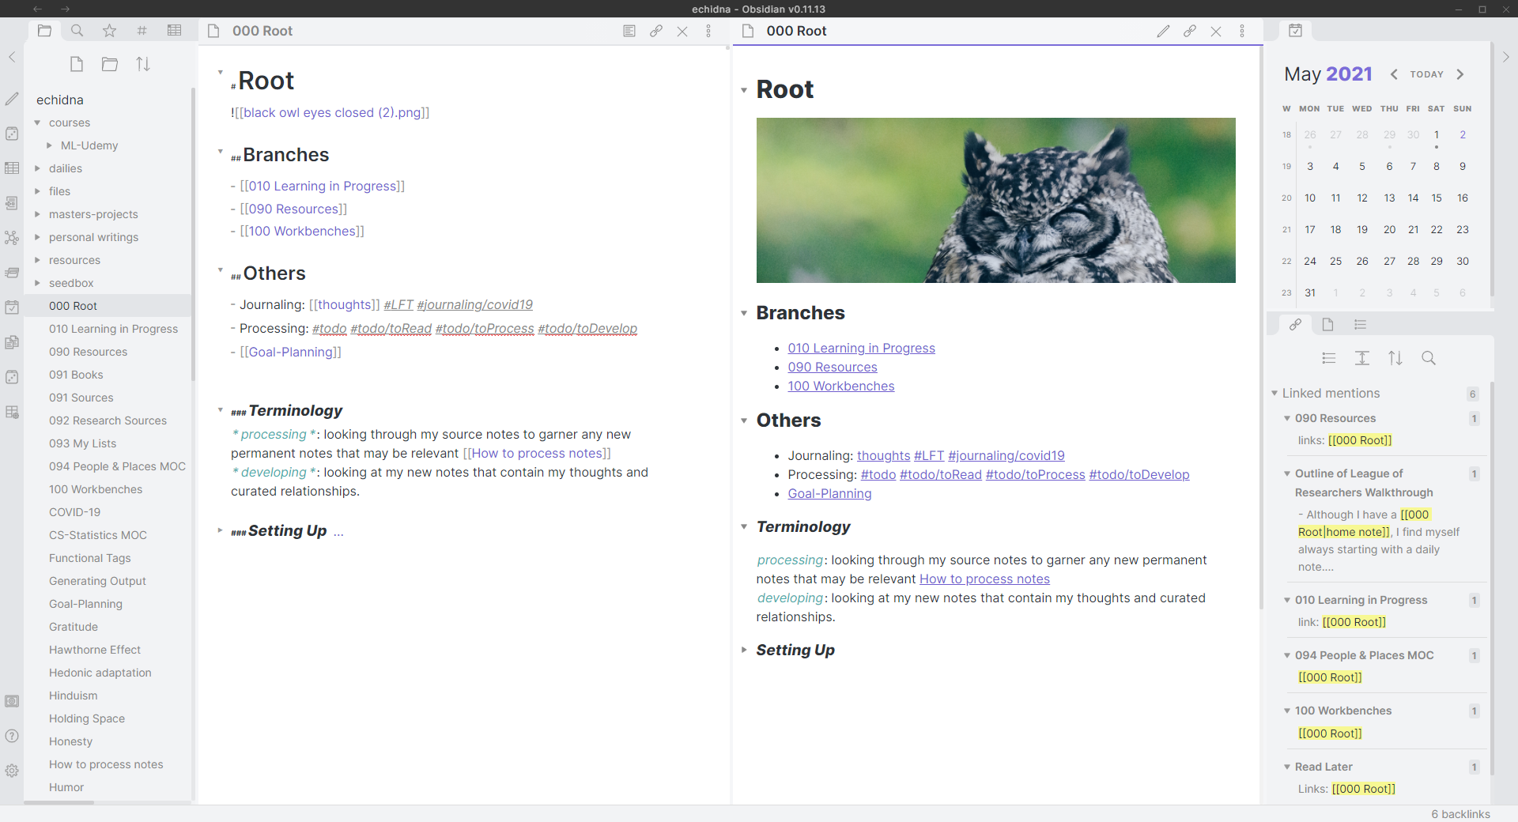
Notes:
My Dashboard + Introducing what Obsidian looks like (flexible)
Note-taking area: Editor mode + Preview mode
File Navigation area
Search tab
Backlink tab
Change Vault + Help Vault + Settings

Slide 16
1
Obsidian Basics
Creating a vault + Setting up
Make a note
Markdown
Wiki-links
Back-links
Panes
Quick Switcher (CTRL-O)
Command Palette (CTRL-P)
Graph view
Notes:
https://drive.google.com/file/d/1Amxqxwllc-mTbzkYQkCqPbHmF7-F4jT0/view
https://www.canva.com/design/DAEWVvlD8xA/Ql9xfC8NY3TBYDc9uXOisQ/edit
Walkthrough is done via the Obsidian app

Slide 17
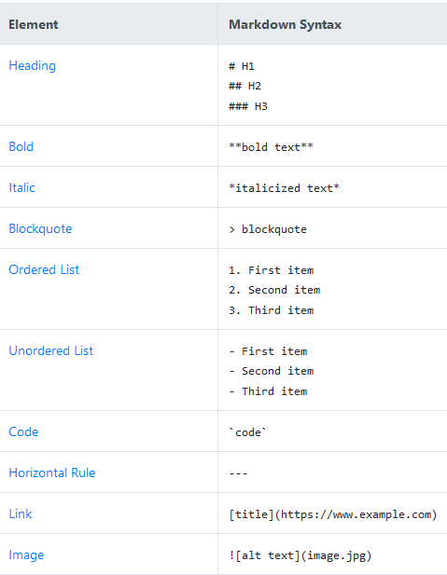
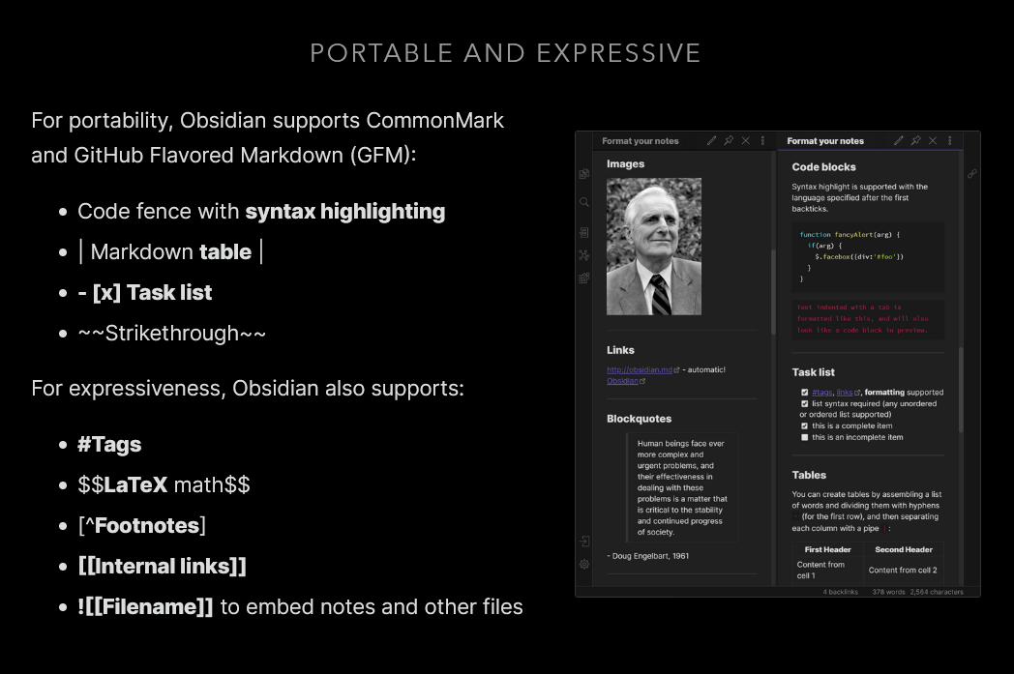
Obsidian Markdown Cheat Sheets
Notes:
Obsidian Help: https://help.obsidian.md/How+to/Format+your+notes
Standard Markdown Cheat Sheet: https://www.markdownguide.org/cheat-sheet/

Slide 18
Breakout Rooms
It’s your turn to try out Obsidian!
Get in groups of 3-4.
One person should screenshare if someone in the group has not downloaded the software yet.
Create some notes, explore the software!
6-8 min
Notes:
After the breakout rooms, pick 1-2 people from each group to share anything they learned or questions they have about the application.

Slide 19
Questions so far?

Slide 20
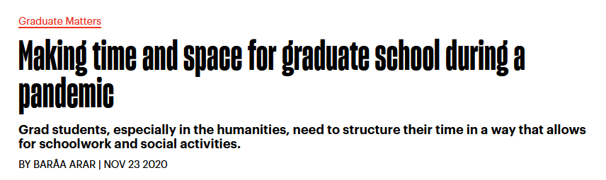
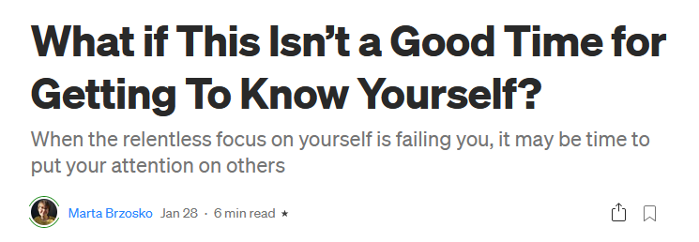
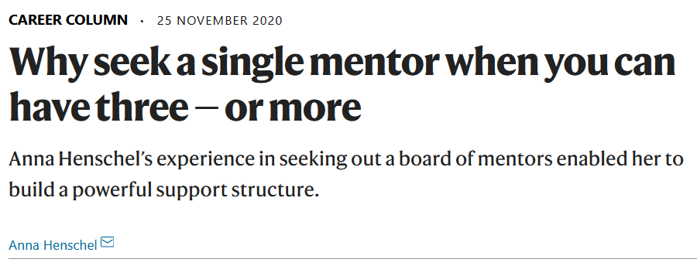
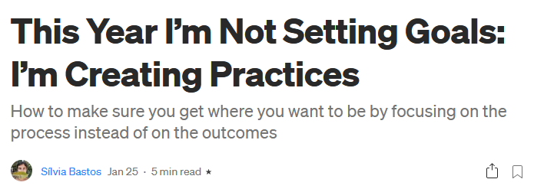
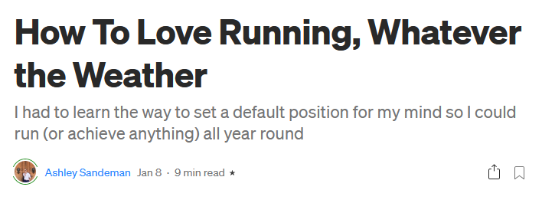
Pick an article, any article
(or have your course notes handy)

Slide 21
2
Taking Notes from an Article
Create a note dedicated to that article
Which part(s) of the article(s) intrigued you? Why?
Does this make you think of another idea or concept?
Does it relate to a personal experience or another piece of media?
Notes:
Walkthrough an example of what I did with one of the articles in Obsidian.

Slide 22
Breakout Rooms
Let’s try taking personal notes with the article you read
Get in groups of 3-4.
One person should screenshare if someone in the group has not downloaded the software yet.
Each person try to create ≥ 1 note based on the article they read.
6-8 min

Slide 23
Resources
Zettelkasten
Building Your Second Brain [1][2]
Justin’s Effective Remote Work - Basics, examples of note-taking workflows.
Nick Milo’s Linking Your Thinking - Example vault you can download
Bryan Jenks Advanced Obsidian Tips
Productivity Guru - technical Obsidian videos
Books
Sonke Ahrens - How to Take Smart Notes
David Allen - Getting Things Done
The Obsidian Discord community and Discourse forums are a great place to ask questions!

Slide 24
Other Topics
Cloud sync
Pinning, Starring Files + Search terms, REGEX
Core/Community Plugins
Templates
Citations
Calendar
Sliding Panes / Obsidian Tab / Cycle Panes/ Pane Relief
Dataview
Outliner
Theme Customization (CSS)
Personal Favorites: Minimal, Discordian
YAML headers (Metadata aka data about data)
Notes:
YAML headers - CSS, Dataview, other plugins...

